Slide 1
CARVER EARLY COLLEGE
Notes:
Good Morning/Afternoon! Today we begin the process of planning our school’s budget for FY23. I know we are all here for the same reason and that is ensuring success for all (enter school name) students. This meeting is to provide an overview of the draft budget and for you to give feedback on the draft budget.

Slide 2
Norms
This is a meeting of the GO Team. Only members of the team may participate in the discussion. Any members of the public present are here to quietly observe.
We will follow the agenda as noticed to the public and stay on task.
We invite and welcome contributions of every member and listen to each other.
We will respect all ideas and assume good intentions.

Slide 3
GO Team Budget Development Process
YOUR SCHOOL STRATEGIC PLAN…
is your roadmap and your role.
It is your direction, your priorities, your vision, your present, your future.
Step 1: Data Review
Step 2: Strategic Plan Review
Step 3: Budget Parameters
(Strategic Priorities)
Step 4: Budget Choices
Notes:
Today I will provide an overview of the budget allocations for FY23. We will begin the work of funding the strategic priorities we agreed upon during our strategic review meeting. (IF YOU HAVE NOT DECIDED ON YOUR PRIORITIES, YOU WILL SAY – WE WILL DECIDE ON OUR PRIORITIES AND THEN DISCUSS ALLOCATING FUNDS TO ADDRESS THOSE PRIORITIES).

Slide 4
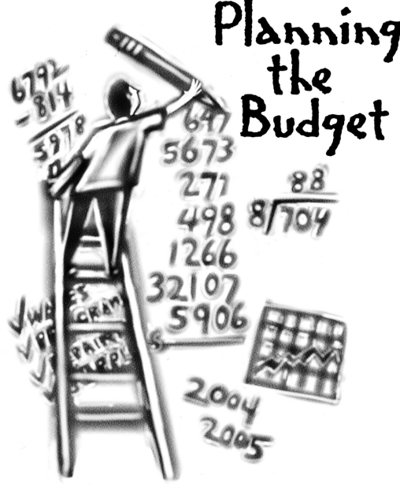
Overview of FY ‘25 GO Team Budget Process
Step 1 Review and Update Strategic Plan and Rank Strategic Priorities
By end of Fall Semester
Step 6 Principals: HR Staffing Conferences Begin
February 26–March 1
Step 3 GO Team Initial Budget Session: Allocation
January 17 – early February
Step 7 GO Team Final Budget Approval Meeting
Budgets Approved by March 15
Step 5
GO Team Feedback Session: Draft Budget Presented & Discussed February – multiple meetings, if necessary
Step 4 Principals: Associate Supt. Discussions and Review
February (supports needed, specific challenges, coaching)
Step 2 Principals: Workshop FY 25 Budget
January 17
GO Teams are encouraged to have ongoing conversations

Slide 5
Budget Allocation Meeting
What
The first GO Team meeting is when the principal will provide an overview of the budget allocation for GO Team members and the general public.
Why
This meeting provides an opportunity for the principal and GO Team to ensure alignment on the school’s key strategic priorities, gain a deeper understanding of the budget allocation, and provide input to drive the direction of the draft budget.
When
End of January- Early February

Slide 6
FY25 Budget Development Process
Principal’s Role
Design the budget and propose operational changes that can raise student achievement
Flesh out strategies, implement and manage them at the school level
Focus on the day-to-day operations
Serve as the expert on the school
Hire quality instructional and support personnel
The GO Team’s Role
Focus on the big picture (positions and resources, not people)
Ensure that the budget is aligned to the school’s mission and vision and that resources are allocated to support key strategic priorities

Slide 7
Carver Early College Strategic Plan

Slide 8
Carver Early College
Strategic Plan
Priority Ranking
Insert the school’s priorities from Higher to Lower
Higher
Increase mastery of core content knowledge for all scholars grades 9-12.
Improve teacher quality and improve delivery of instruction.
Provide increased learning opportunities that offer customized instruction creating exposure, expression, and global awareness.
Prepare all students for post-secondary and career experiences
Maximize and align partnerships, policies, and procedures to support school needs.
Lower

Slide 9
FY25 Budget Parameters
FY25 School Priorities | Rationale
Increase mastery of core content knowledge for all scholars grades 9-12. | Our content mastery score for the 2024 school year was 35 which falls significantly below our expected performance rate
Improve teacher quality and improve delivery of instruction. | As we aim to increase rigor and increase the number of scholars entering college without needing remediation, there is a need to invest in professional learning opportunities for teachers.
Provide increased learning opportunities that offer customized instruction creating exposure, expression, and global awareness. | As we endeavor to strengthen the early college model and implement STEM as the signature program, it is imperative that we incoporate more real-world, relevant experiences
Notes:
Review the priorities that the GO Team has developed and the rationale for these priorities. Feel free to copy this slide if you have more than 3 priorities to account for.

Slide 10
FY25 Budget Parameters
FY25 School Priorities | Rationale
Prepare all students for post-secondary and career experiences | Scholars who graduate from early college must be prepared to meet the demands of a diverse world
Maximize and align partnerships, policies, and procedures to support school needs. | Ensure that partnerships will advance the learning opportunities for the scholars and the teachers at Carver Early College
Notes:
Review the priorities that the GO Team has developed and the rationale for these priorities.

Slide 11
Discussion of Budget Summary
(Step 4: Budget Choices)

Slide 12
Executive Summary
This budget represents an investment plan for our school’s students, employees and the community as a whole.
The budget recommendations are tied directly to the school’s strategic vision and direction.
The proposed budget for the general operations of the school are reflected at $____7,675,304
This investment plan for FY25 accommodates a student population that is projected to be _525____ students, which is a increase/decrease of _93_____ students from FY24.
_
Notes:
Here’s a few highlights for our budget this year – read executive summary

Slide 13
School Allocation
Notes:
For FY23, APS is continuing to increase equity within the District and the flexibility principals have in regards to our schools budgeted funds. The new Student Success Funding Model (SSF) allocates dollars to schools based on the number of enrolled students and receives a funding "weight" based on need. This year, student characteristics were weighted based on:
Grade Level –
K-12
Poverty – Weighted for all Direct Certification enrolled students.
Beginning Performance – Weighted Middle School and High School students entering with beginner’s performance on milestones.
ESOL – Weighted for all ESOL designated students in order to supplement due to ESOL staff being locked.
Special Education - Weighted for all Special Education students.
Gifted – Weighted and measured by number of students in the Gifted Program
Small School Supplement – Weighted for low enrollment schools
ES – 500
MS – 600
HS – 700
As you can see, our projected enrollment for FY23 is _______, we increased/decreased by __________ from last year.
We received the following weights for our student characteristics: (Below is just for the script, principals need to insert their school’s characteristics)
Grade Level
Poverty
Special Education
Gifted
Gifted Supplement
ELL
Small School Supplement

Slide 14
School Allocation
Notes:
Additionally, we received money for signature programming, turnaround, Title I and FTE Allotments.

Slide 15
School FY25 CARES Allocation
In addition to a General Fund allocation, our school has been allocated CARES funding that must be used to support implementation of the school-based intervention block and other school-based needs as a result of the COVID-19 Pandemic.
Once the support needed to implement our school-based intervention block/course has been fulfilled, we can use the remaining CARES funds to address other school-based needs that are a result of the COVID-19 Pandemic.
Notes:
Please add your school’s CARES Allocation to this slide.

Slide 16
What’s Next?
January
GO Team Budget Allocation Meeting (Jan. 17th-late February)
February
One-on-one Associate Superintendent discussions
Cluster Planning Session (positions sharing, cluster alignment, etc.)
Program Manager discussions and approvals
GO Team Feedback Meeting(s) before principal’s staffing conference
HR Staffing Conferences (February 26 – March 1)
March
Final GO Team Approval Meeting (AFTER your school’s Staffing Conference and BEFORE Friday, March 15th)
Notes:
In February, we will meet again to discuss how the school’s budget has been allocated to support the programmatic needs and FY23 key strategic priorities.
If think we need to continue our budget conversations, we will schedule additional meetings. My goal is to make sure your voices are reflected in our school’s budget.
I will also be meeting with my Associate Superintendent, program managers and other key leaders to go over our budget and to make sure the school is meeting the standards of service and appropriately staffing.
During the week of Feb. 24th -March 2nd , HR Staffing Conferences will be held. At this meeting, I will present my plan for staff utilization, resource distribution and plan for staffing implications.
We will need to approve the budget at the ________ meeting.

Slide 17
Questions?
Thank you for your time and attention.
Notes:
IF YOU FEEL YOUR TEAM IS READY TO APPROVE THE DRAFT BUDGET, PLEASE DO SO. PLEASE REMIND THEM THAT YOU MAY NEED TO MEET WITH THEM AGAIN, IF THERE ARE CHANGES FROM YOUR MEETINGS WITH DISTRICT LEADERSHIP. LET THEM KNOW YOU WILL KEEP THEM INFORMED!!

